Slide 1


Predictive Modelling
Workshop 10th Dec 2024
British Ecological Society Annual Meeting

Slide 2
Purpose of models
‘All models are wrong, but some are useful’ – Box (1976)
Hypothesis building (increasing X will result in decreases in Y)
Predictions
Of climate change
Of exploitation (e.g. fishing)
Of policy
Trade-off between accuracy and simplicity

Slide 3
Purpose of models
‘All models are wrong, but some are useful’ – Box (1976)
Hypothesis building (increasing X will result in decreases in Y)
Predictions
Of climate change
Of exploitation (e.g. fishing)
Of policy
Trade-off between accuracy precision and simplicity

Slide 4




What do we want to study?
When?
What?
Where?

Slide 5
Node: species of interest
Plant
Rabbit
Lion
Soil

Slide 6
Node: species of interest Edges: direct relationship between nodes
Too many rabbits prevent plant recovery!
Let’s have some rabbit for dinner!
Dropping from lions and rabbits acts as fertilisers
Plant
Rabbit
Lion
Soil

Slide 7
Node: species of interest Edges: direct relationship between nodes
Negative relationships (e.g. one INcrease when second DEcrease) = values -1 to -4
Positive relationships (e.g. one INcrease when second INcrease) = values 1 to 4
Plant
Rabbit
Increase in lions → Decrease in Rabbits
Lion
Soil
Increase in rabbits → increase in nutrients in the soil

Slide 8
Node: species of interest Edges: direct relationship between nodes
Negative relationships (e.g. one INcrease when second DEcrease) = values -1 to -4
Positive relationships (e.g. one INcrease when second INcrease) = values 1 to 4
 | Lion | Rabbit | Plant | Soil
Lion |  | -3 |  | 2
Rabbit |  |  | -2 | 3
Plant
Soil |  |  | 4

Slide 9
Which scenario do we want to explore?
We believe there will be a reduction on the number of lions on the ‘S area’ due to reallocation of population to the ‘Y area’ of the natural reserve over summer.
What will be the effect of this in the ‘S area’?
Increase | Node
-4 | Lion
0 | Rabbit
0 | Plant
0 | Soil
Low predator density
No change in plant cover
No change in prey population
No change in soil properties

Slide 10
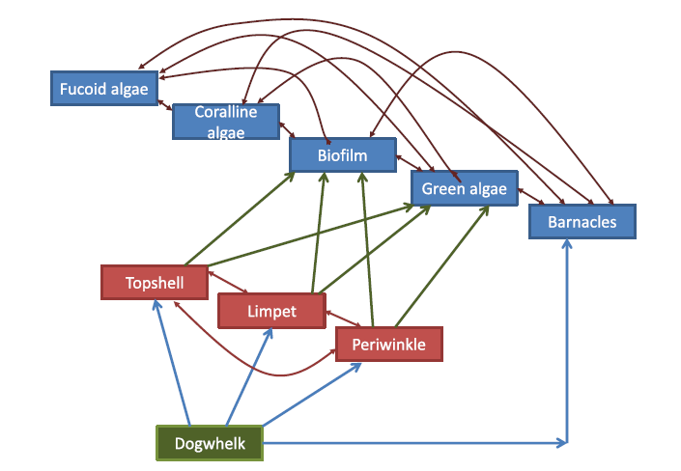
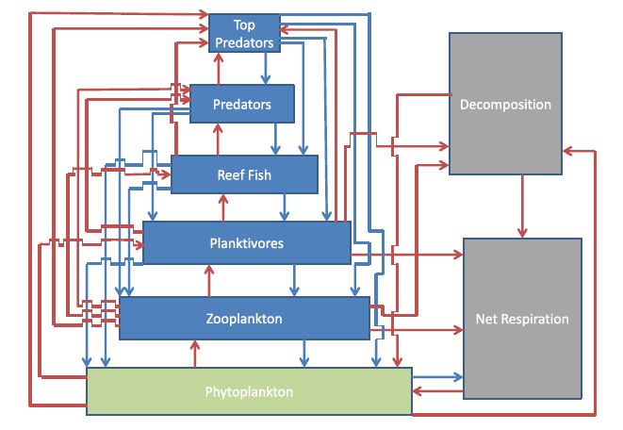
‘Pure’ Ecology models
Stafford et al. 2015 Spiers et al. 2016

Slide 11
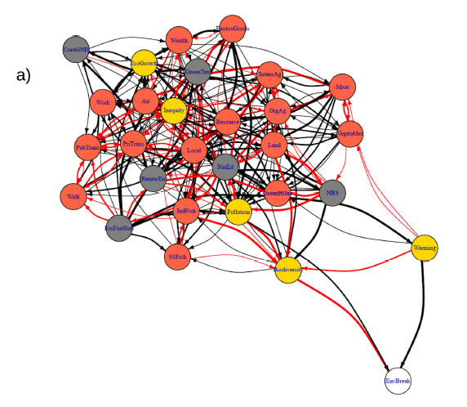
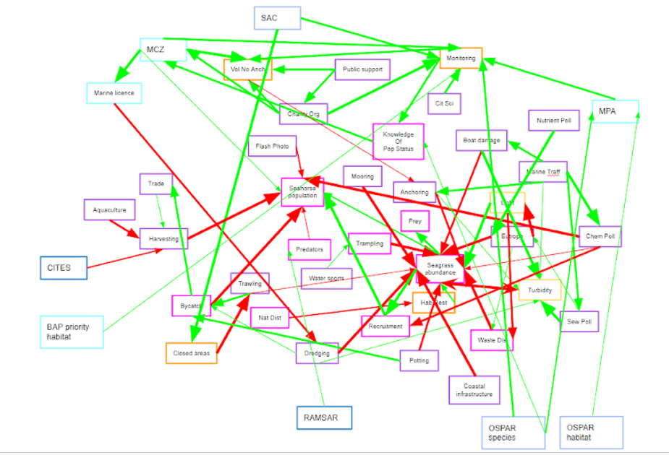
Applied ecological and environmental models
Harris 2023 Stafford et al. 2020

Slide 12
Designing a model – hints and tips
Outputs – dependent variables
What do you want to know – can be multiple things, and they can interact
Species, communities, ecosystem services, social outcomes can all be outputs
Inputs – independent variables
Why will a system change?
Policy
Climate
Species introduction or removal
Direct interactions
We model direct interactions, which are more obvious
E.g. lions eat rabbits, rather than lions result in more grass

Slide 13
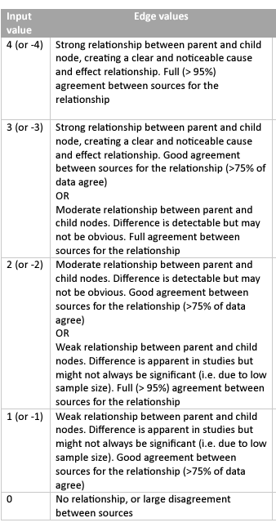
Creating an interaction matrix
Positive relationships (e.g. one INcrease when second INcrease) = values 1 to 4
Negative relationships (e.g. one INcrease when second DEcrease) = values -1 to -4
 | Lion | Rabbit | Plant | Soil
Lion |  | -3 |  | 2
Rabbit |  |  | -2 | 3
Plant
Soil |  |  | 4
Row effects column
Direct interactions only
Interactions can be reciprocal
Matrix made in a spreadsheet program and saved as csv file

Slide 14
Which scenario do we want to explore?
We believe there will be a reduction on the number of lions in our reserve due to reallocation of the full population to another location.
What will be the effect of this?
Increase | Node
-4 | Lion
0 | Rabbit
0 | Plant
0 | Soil
Low predator density
No change in plant cover
(directly)
No change in prey population
No change in soil properties

Slide 15
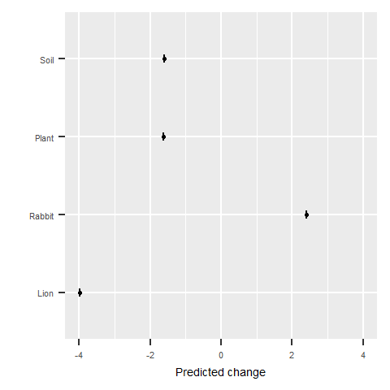

Bayesian Belief Networks
Nodes and edges information:
Evidences
Prior knowledge: What we initially believe is happening
PREDICTION
Posterior knowledge: Updated belief

Slide 16
Building scenarios
Use the same list of nodes, and in the same order, as for the interaction matrix.
Think about direct changes only
i.e. if we remove lions, we don’t think about the consequences on rabbits… the model does this thinking
We indicate increases or decreases in nodes which stem from these direct changes
Others are scored as zero

Slide 17

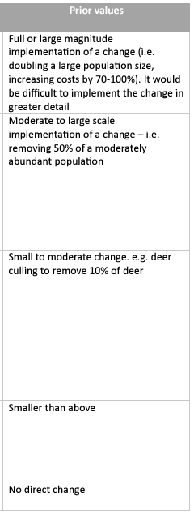
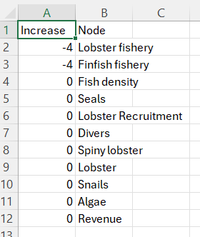
First column – named ‘Increase’ with changed values
Second column – named ‘Node’ – these names will be used in any output
Must be same order as in interaction matrix
Save as a csv file

Slide 18
The BBNet package
Run a predictive model
1
Create an interaction diagram from the interaction matrix
2
Perform sensitivity analysis on the interaction matrix to guide areas in need of most input from literature / data collection
3
Visualise information flow through the matrix
4

Slide 19
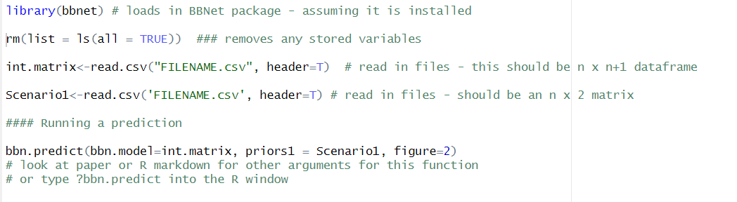
Running a prediction
An R script and R Markdown detailing these processes are available in the resources folder

Slide 20
Parameterising a model
Use of prior knowledge
Group discussion
Sensitivity analysis
bbn.sensitivity(bbn.model = ‘FILENAME.csv’, boot_max = 100, ‘Node1', ‘Node2’)

Slide 21
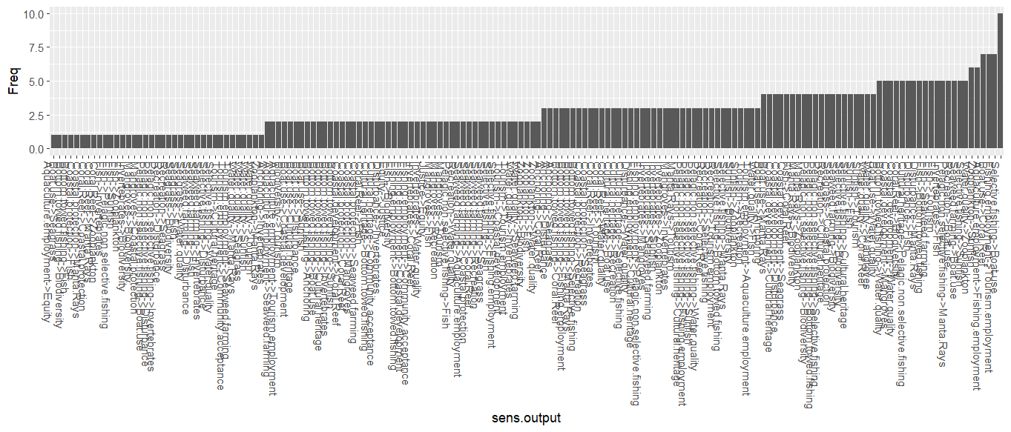
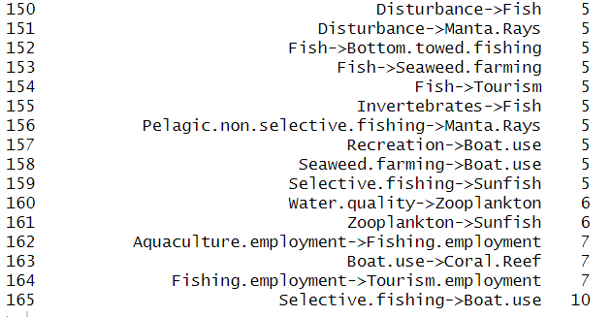

Slide 22
Final Thoughts
Models can be used for very complex scenarios
See https://www.researchsquare.com/article/rs-4609771/v1 for details of environmental, economic and political landscape in the UK
Can easily join up social and natural systems
Can convert qualitative data into ‘semi’-quantitative predictions
Exploring use of AI including notebook LM for this
But do not give fully quantitative outputs (ordinal values)
In some cases, different modelling approaches (e.g. agent-based models) would be more appropriate

Slide 23
Help and Support
Rick – rstafford@bournemouth.ac.uk
Vicky - V.Dominguez-Almela@soton.ac.uk
Paper - https://www.biorxiv.org/content/10.1101/2024.06.12.598033v1 - currently in press in PloS ONE
Please cite the PLoS ONE paper if you use the package, so we can keep track of who is using this
Community help forum:
https://www.reddit.com/r/BBNet

Slide 24

Feedback
joining code is: 3282 3905

